Slide 1
Social Issues-1 Harassment

Slide 2
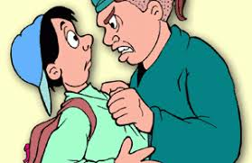

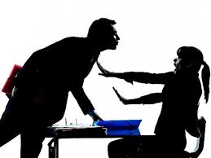
Definition
Aggressive pressure or intimidation.
Disturbing an individual physically or emotionally

Slide 3
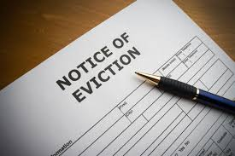
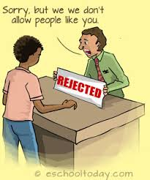
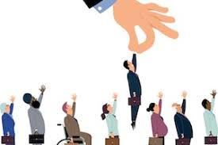
It can refer to …
Threats of eviction
Loss of employment
Denial of rights
Discrimination on the basis of caste, creed, ethnicity or race.

Slide 4
Types
Work place Harassment
Psychological Harassment
Racial Harassment
Religious Harassment
Sexual Harassment
Misuse of authority
Cyber related harassment
Dowry Harassment

Slide 5
Work place Harassment
Abusing a person loudly in the presence of others
Repeated threats of dismissal for a flimsy reason
Constant ridicule
Offensive messages
Hiding documents, deliberately giving wrong information or withholding information.
Humiliating through gestures, sarcasm, criticism and insult.
Spreading rumours and gossiping.

Slide 6
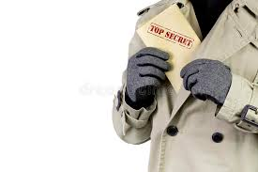
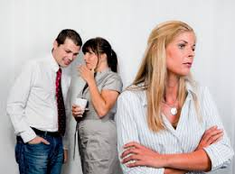
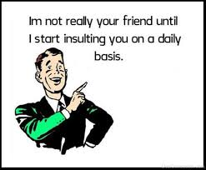
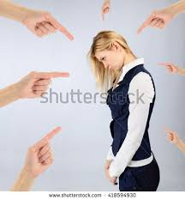

Slide 7

Psychological harassment
Umbrella term, at work place it means the employer demeaning the employee.
Forcing to work in a humiliating condition.
Destroying a person’s emotional balance.
Harassing techniques: denial of contacts, work, isolation.
The harassed person develops post-traumatic stress syndrome.

Slide 8
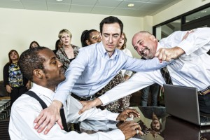
Racial Harassment
Racial discrimination refers to discrimination against individuals on the basis of their race.
Racial Harassment occurs when a person or group repeatedly use discriminatory remarks, behaviours or practices to show racial intolerance against a co-worker or their colour, descent, culture, language or religion.

Slide 9
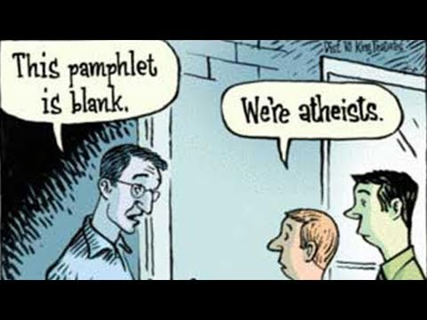
Religious Harassment
Preaching one’s faith to others through force.
Preaching it in workplace
Proselytize - convert or attempt to convert (someone) from one religion, belief, or opinion to another.
Proselytizing – complicated form of religious harassment.

Slide 10

Sexual Harassment
harassment (typically of a woman) in a workplace, or other professional or social situation, involving the making of unwanted sexual advances or obscene remarks.

Slide 11
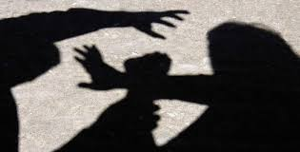
Sexual harassments includes…
Rape or sexual assault
Pressure for sexual pleasures
Deliberate touching, leaning over, cornering or pinching.
Unwanted sexual looks, gestures, teasing, jokes, remarks or questions
Unwanted letters, telephone calls, or material of sexual nature.

Slide 12
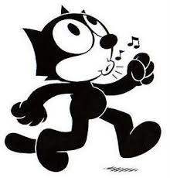
Whistling, cat calls, sexual comments, innuendos or stories.
Referring to an adult as girl, hunk, doll, babe or honey
Turning work discussions to sexual topics, unwanted pressure for dates,
Touching an employee’s clothing, hair or body.
Hugging, kissing, patting or stroking
Etc.,

Slide 13
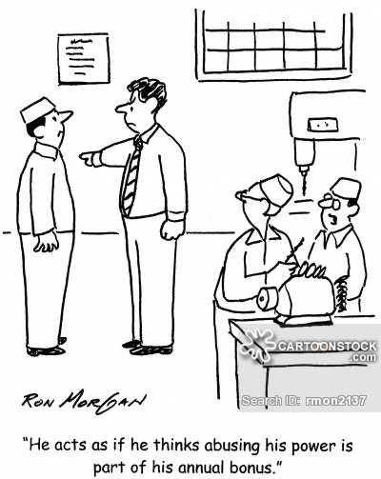
Misuse of Authority
The misuse of power or authority in the course of performing work.

Slide 14
Abuse of power or authority can take various forms…
Bullying or harassing behaviour
Requesting staff to do personal errands or favours
Pressuring staff to distort facts or break rules.
Interfering with the ability of colleague to work effectively.
Tapping the phone of political opponents
Torture of prisoners by officials
Creation of surveillance society
Political spying.

Slide 15
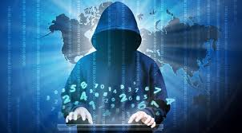
Cyber related harassment
With reference to electronic communication
Cyber stalking : to stalk someone, generally refers to pattern of threatening of malicious behaviours.
Cyber Harassment : it pertains to threatening or harassing emails, blog entries, websites dedicated solely to tormenting an individual.
Cyber Bullying: online bullying or harassment. – states have enacted cyber bullying laws.

Slide 16
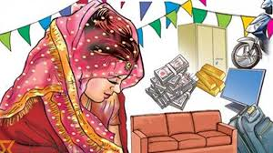
Dowry Harassment
It constitutes to be a major issue in marriage.
Payment of dowry – prohibited – 1961 – Indian Penal code - sections 304B and 498A
Penalty for dowry- imprisonment for six months to two years.
Dowry death – not less than 7 years to life time imprisonment.

Slide 17


